Slide 1
Animoto
Don R. Shegog, II

Slide 2
What Is Animoto?
Animoto is an easy way to create video slideshows
Pictures
Video Clips
Music

Slide 3
Signing up for an account
Visit Animoto.com
Click on SIGN UP
Enter the required information
Once the account is created
Open a new tab
Visit - https://animoto.com/education/classroom
Click on APPLY NOW
Enter the required information (use the same email used to make the account above)
Check your email for the code
Enter the code for a years worth of free Animoto educators account + 50 free accounts for students

Slide 4
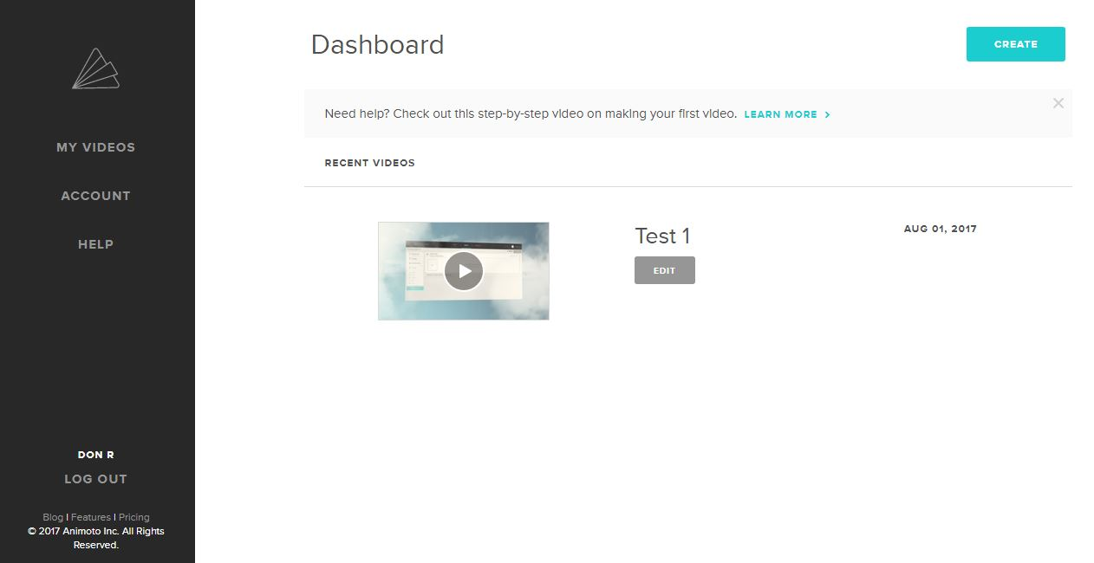

Slide 5
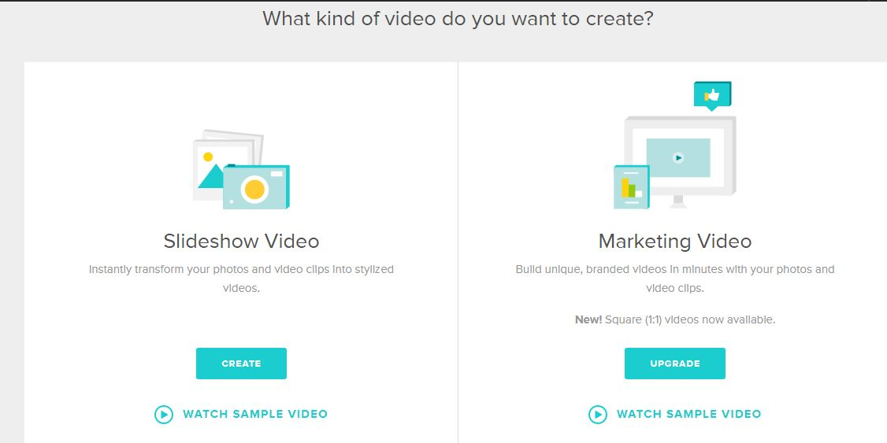
Creating a Video

Slide 6
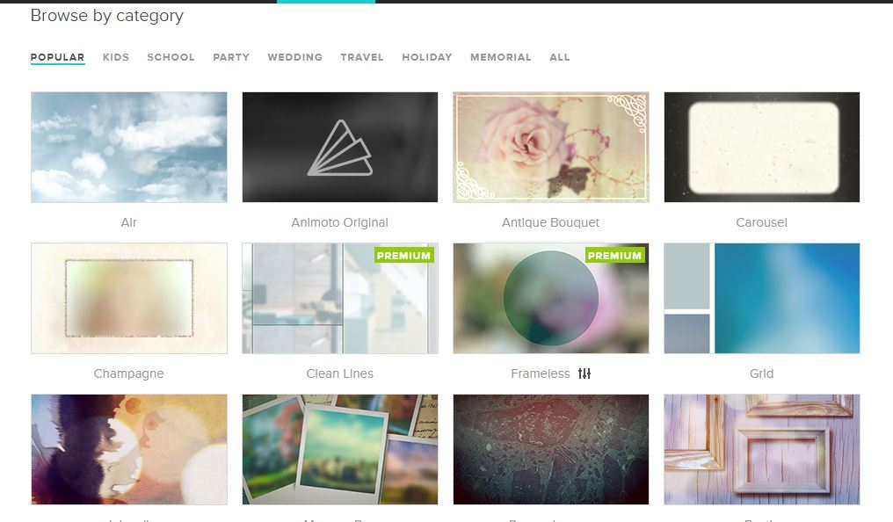
Choose Style

Slide 7
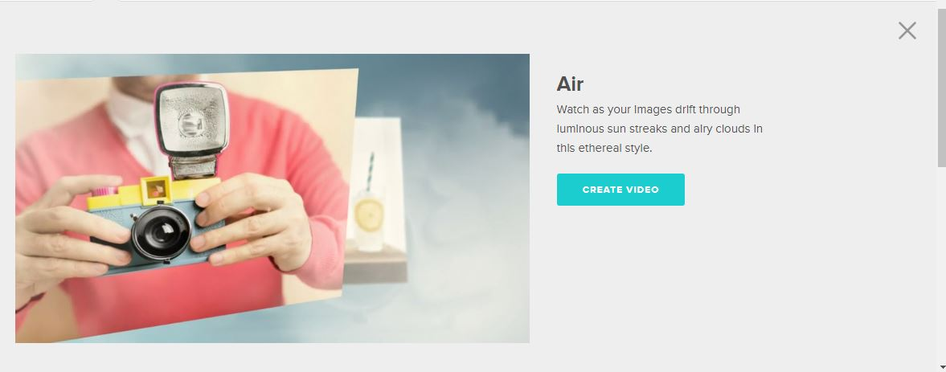
Style Preview

Slide 8
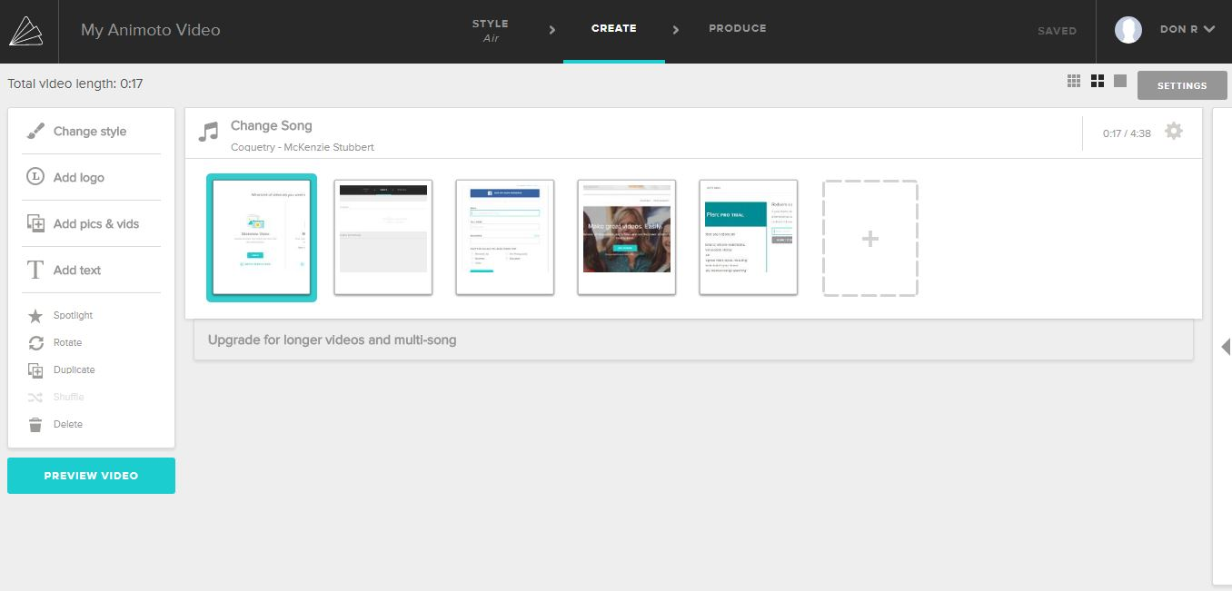







Click to change song
Arrange pictures by clicking and dragging
Edit song and picture pacing
Click to add pictures
Click to change the style
Click to add a text slide
Click to preview the video
Add captions and edit pictures

Slide 9
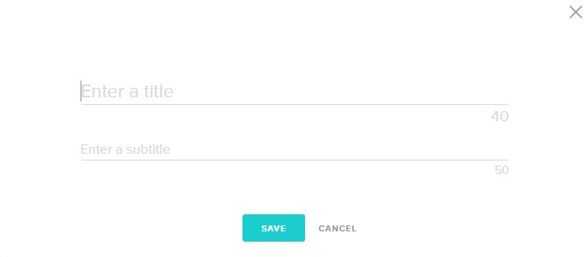
Insert Text Slide

Slide 10
Choose Style

Slide 11
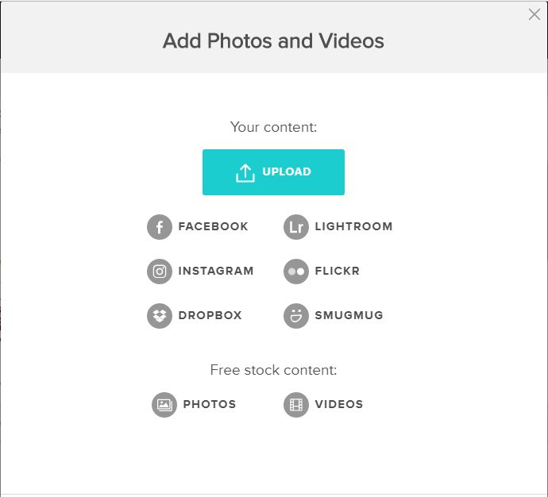
Add Pictures

Slide 12
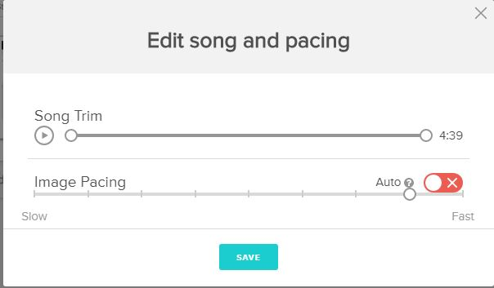
Edit song and pacing
Pictures remain onscreen longer
Pictures remain onscreen shorter

Slide 13
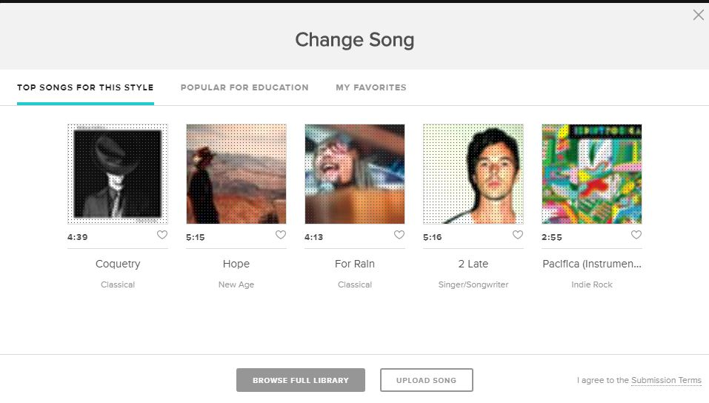
Change Song

Slide 14


Highlight, Caption and Photo Editing
Create a caption for the picture
Highlight the picture – causes it to show longer than the standard picture
Opens a basic photo editor

Slide 15
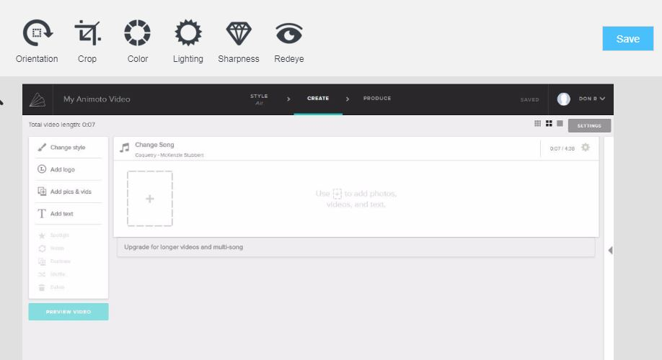
Basic Photo Editing

Slide 16
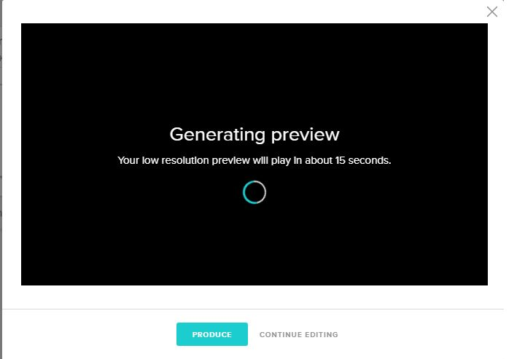


You will see a low resolution preview
If you like what you see, Click Produce to finish the process
If you are not done or do not like it, click Continue Editing to continue working

Slide 17
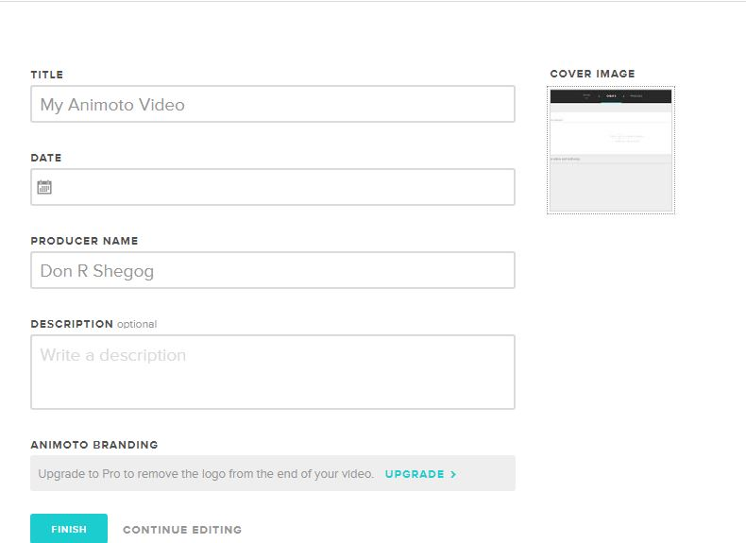
Producing
Allows you to change the cover Image
*Give the project a name
Date the project
Give a producers name
Describe the project
Only items with a (*) are required, all others are optional
Click finish when you are done

Slide 18
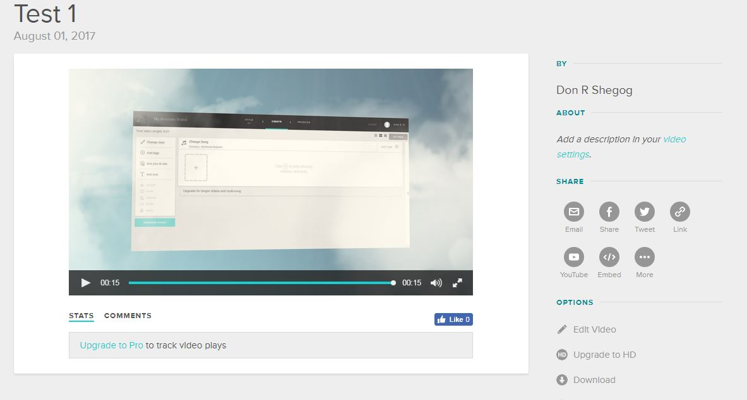
Finished
Links to share the video
Options to re-edit the video or upgrade the resolution

Slide 19
Uses
Back to school Video
Book Report
Introduction
Lagniappe

Slide 20

Book Report
BACK

Slide 21

Back To School
BACK

Slide 22

Introduction
BACK

Slide 23
Lagniappe
Save PowerPoint Slide as pictures
PowerPoint for Mac | PowerPoint 2013
Click File Click Export Choose the location to save the files Change the format in the Format Box to jpeg Click Save | Click File Click Export Click Change File Type Choose JPEG Interchange Format Click Save As Choose the location to save the files Click Save
There will be a folder containing all of the slides saved as individual pictures

